Slide 1
Programming Fundamentals
By
Shazmeen Batool

Slide 2
Today’s Lecture
Increment Decrement Operators
Augmented Assignment Operators
Type Casting and Named Constants
Escape Sequences

Slide 3
Type Casting
Type casting in C++ is a way to convert a variable from one data type to another. It’s like telling the computer, "Treat this value as if it were a different type."
For example, if you have a number stored as a floating-point (like 3.14) but you want to use it as an integer (3), you can use type casting to convert it.

Slide 4
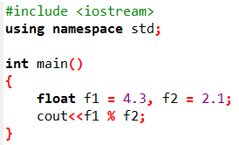
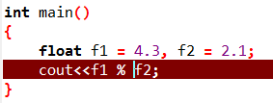
What is the output of the following program?
Keep this in mind before answering:
% (remainder or modulo) is the special operator just for integer. It yields an integer as the result.

Slide 5
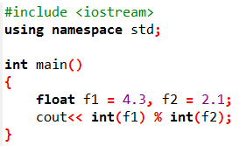
What is the output of the following program?

Slide 6
Activity
Ask user to enter two floating point numbers and calculate their modulus.

Slide 7
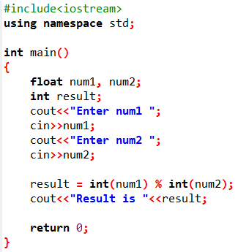


Slide 8
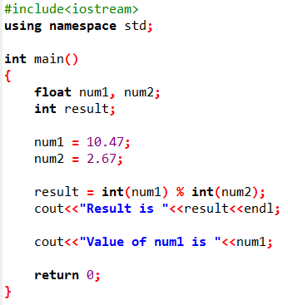

Activity
Casting does not change the variable being cast
Output:

Slide 9
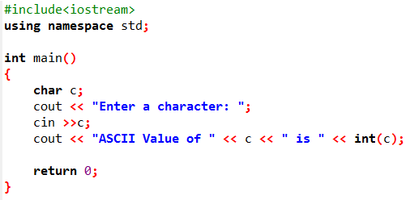

Print ASCII Value in C++

Slide 10
Named Constants
Named constant is an identifier that represents a permanent value.
Syntax: const datatype ConstantName = value;

Slide 11
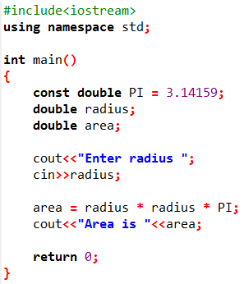

Example
Take radius as input from user and calculate its area.

Slide 12
Increment and Decrement Operators
Operator | Name | Description | Example(assume i = 1)
++var | preincrement | Increment var by 1 and use the new var value of a in the statement. | int j = ++i; //j is 2, i is 2
var++ | postincrement | Increment var by 1, but use the original var value in the statement. | int j = i++; //j is 1, i is 2
--var | predecrement | Decrement var by 1 and use the new var value of a in the statement. | int j = --i; //j is 0, i is 0
var-- | postdecrement | Decrement var by 1 and use the original var value in the statement. | int j = i--; //j is 1, i is 0

Slide 13
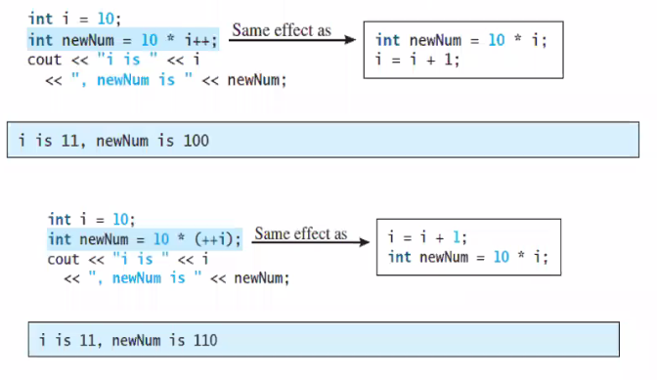
Increment and Decrement Operators

Slide 14
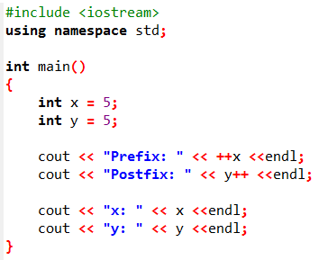

Example

Slide 15
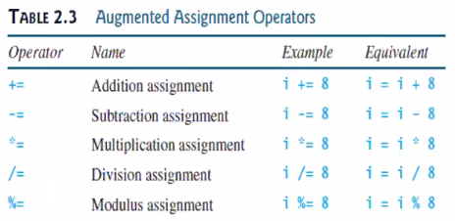
Augmented Assignment Operators

Slide 16
Escape Sequences
The backslash is called the escape character.
It tells the compiler that the next character is “escaping” it’s typical definition and using its secondary definition.

Slide 17
Escape Sequences
Escape Sequence | Description
\n | Newline. Position the cursor at the beginning of the next line.
\t | Horizontal tab. Move the cursor to the next tab stop.
\b | Backspace. It deletes or removes one character which is written before
\r | Carriage return. Position the screen cursor to the beginning of the current line; do not advance to the next line.
\a | Alert. Sound the system bell.
\\ | Backslash. Insert a backslash character in a string.
\' | Single quote. Used to print a single quote character.
\" | Double quote. Insert a double-quote character in a string.

Slide 18
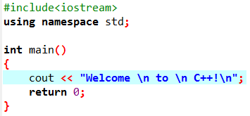
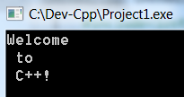
Example

Slide 19
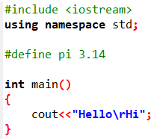

Example

Slide 20
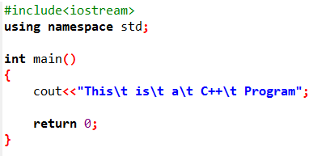
Activity
Print the message "This is a C++ program". Separate each word from the next by a tab.
Output:

